Slide 1

HIGH-LEVEL SYSTEM DESIGN
SG Culture Pass AI Chatbot
An event recommender and outing planner that reasons about everyone you are going with, and a technical walk-through of two use cases
Group 4 · Adhithi · Abinaya · Saranya
NUS-ISS Intelligent Reasoning Systems practice module
sg-culture-pass-chatbot.streamlit.app
Notes:
ADHITHI (0:00)
We are Group 4. This is the high-level design of our SG Culture Pass AI chatbot: an intelligent event recommender and outing planner.

Slide 2
1 · THE PROBLEM
The credits are there; choosing is hard
1.4M
411k
~10%
Singaporeans registered for SG Culture Pass
had used any of their S$100 credit
of the S$300 million set aside was spent
A year after launch (MCCY one-year update, reported by Loh, 2026)
Fixed filters only
A keyword search bar
No planning, no reasons
Genre, date, price band, rating, language. No place, no specific interest, no way to check a whole group at once.
One natural request returned 165 results to read through.
Nothing combines events into a day out, or says why an event suits you.
SG Culture Pass AI Chatbot · Group 4 · High-level system design
2 / 15
Notes:
ADHITHI (0:12)
Culture Pass provides a hundred dollars to eligible adults, yet only 411,000 of 1.4 million registrants had used credits after a year. The challenge is choosing: filters and keyword search leave people to reconcile ages, interests, budgets and travel themselves.

Slide 3
1 · OUR ANSWER
One request in your own words, one explained answer out
“Something hands-on for my 2 kids (6 and 9) this weekend near Tampines, under $30”
1
Asks only questions that change its advice
Value of information decides whether a question is worth the user's time.
2
Never relaxes age or access limits
Other limits may be loosened when too few events fit, and every loosening is labelled.
A short, explained shortlist
✓ About crafts ✓ Rated General, fine for a 6-year-old
3
Explains every pick and can plan a day
✓ On Sat 12 Sep ✓ From $9 per person
Reasons come from the reasoning trace; the planner orders stops with travel time.
…or a timed plan for the whole day
SG Culture Pass AI Chatbot · Group 4 · High-level system design
3 / 15
Notes:
ADHITHI (0:34)
Our system turns one natural-language request into an explained shortlist or day plan. Unlike simple retrieval, it evaluates suitability, asks worthwhile questions, and clearly labels alternatives when constraints must be relaxed.

Slide 4
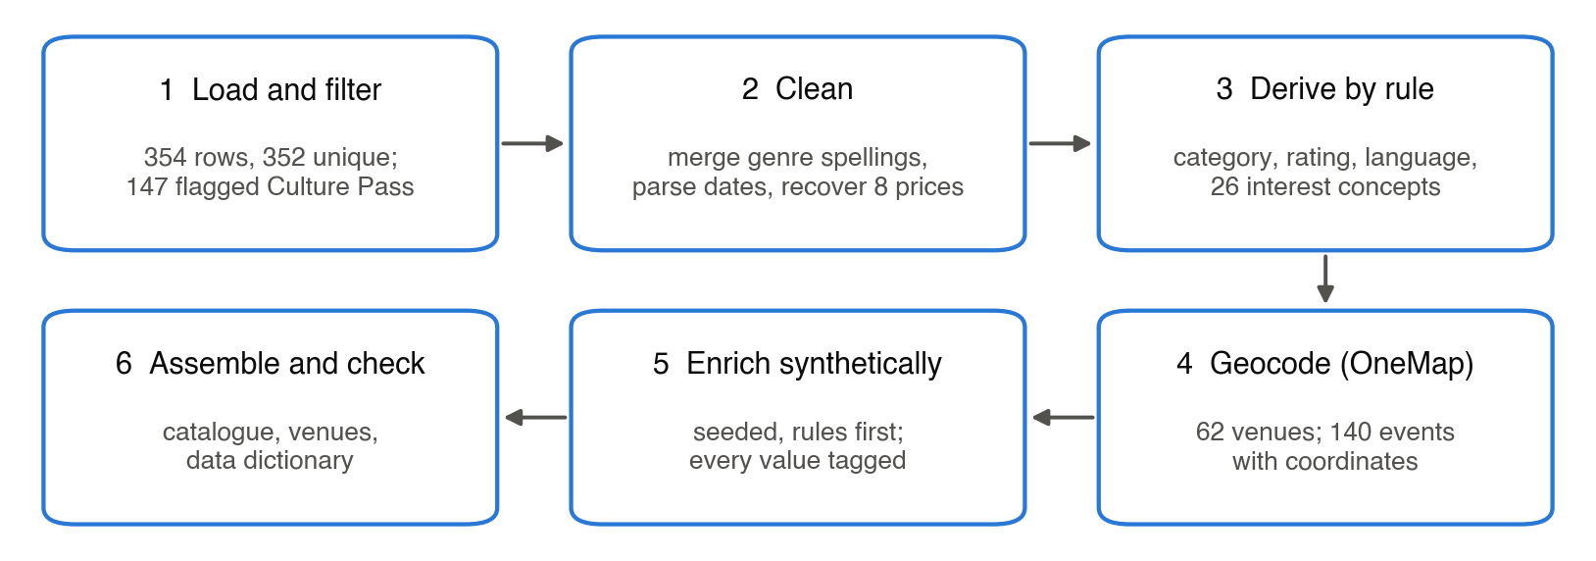
2 · DATA STRATEGY
From a SISTIC snapshot to a Culture Pass knowledge base
354
352
147
140
SISTIC records,
pulled 11 Sep 2026
after removing
duplicates
flagged Culture Pass
by SISTIC
with venue coordinates
from OneMap
Six scripted steps rebuild the same catalogue on every run. The pull date is also the chatbot's “today”.
SG Culture Pass AI Chatbot · Group 4 · High-level system design
4 / 15
Notes:
SARANYA (0:51)
We used a fixed SISTIC snapshot because the complete Culture Pass dataset was unavailable. Of 354 records, 147 were flagged Culture Pass events; OneMap supplied coordinates for 140. This snapshot anchors reproducible recommendations.

Slide 5
2 · DATA STRATEGY
Every gap filled honestly, and tagged
Missing site filters
Messy venue names
Thin categories
SISTIC has no rating, language, group-friendly or accessibility fields.
Automatic geocoding failed for 16 of 62 venues.
65 Music, 43 Visual Arts, 15 Heritage, 12 Theatre, 10 Dance, 2 Literary Arts, 0 Films.
Fix Rules first (children's events are rated General), then seeded synthetic values by category.
Fix 12 resolved by hand from published addresses; 7 events say “location unknown” rather than guess.
Fix The chatbot says when nothing matches, and labels the alternatives.
Every column carries a provenance tag
Results are split by the data they depend on: 22 real-data, 3 rule-derived and 14 synthetic-data scenarios. Synthetic results only show the reasoning works.
real (SISTIC, OneMap)
rule-derived
synthetic
SG Culture Pass AI Chatbot · Group 4 · High-level system design
5 / 15
Notes:
SARANYA (1:09)
Some rating, accessibility and group attributes were missing. We derived what rules could support and seeded the rest synthetically, with provenance tags. Therefore synthetic-dependent results test reasoning over assumed attributes, not verified event suitability.

Slide 6
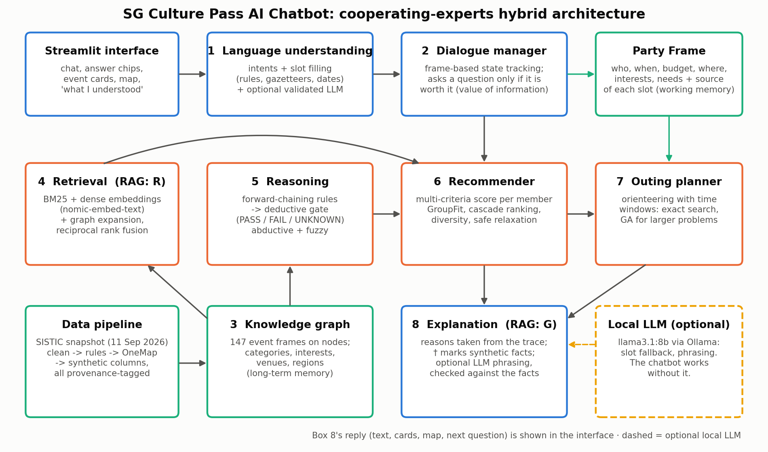
3 · SYSTEM DESIGN
Eight specialist layers
Long-term memory
A knowledge graph: 147 event frames, 256 nodes, 1,045 edges.
Working memory
The Party Frame: who is going, when, budget, where, interests, needs. Each slot records whether it was stated, answered or assumed.
Optional LLM
The dashed box: fills slots the rules missed and phrases one sentence. Both are checked; it never decides.
SG Culture Pass AI Chatbot · Group 4 · High-level system design
6 / 15
Notes:
ABINAYA (1:27)
The eight layers form a cooperating-experts architecture. Language rules build the Party Frame; a dialogue manager may clarify it. The knowledge graph stores event frames; hybrid retrieval proposes candidates. Deductive and fuzzy reasoning evaluate them, group scoring ranks them, and planning and explanations produce the response. The optional local LLM never decides eligibility.

Slide 7
3 · SYSTEM DESIGN
Each need, the technique that serves it, and the evidence
What users need | Technique chosen | Evidence
Understood in my own words | Rules, place names and date rules (layer 1) | F1 0.98, against 0.48 for an LLM
Not quizzed, not misread | Party Frame + value-of-information questions (layer 2) | Vague requests 0.33 → 0.57
Respect stated hard limits | Forward-chaining rules and a deductive gate (layer 5) | 9% violate hidden needs; 63% for Llama + catalogue
Practical for everyone going | Fuzzy practicality + GroupFit scoring (layers 5, 6) | Fuzzy lifts day plans 0.81 → 0.91; GroupFit's gain not yet shown
A plan for the day | Exact search; genetic algorithm when large (layer 7) | Optimal on all 56 test problems, 44 ms
Reasons I can trust | Explanations from the reasoning trace (layer 8) | 28 of 28 LLM openings passed the fact check
SG Culture Pass AI Chatbot · Group 4 · High-level system design
7 / 15
Notes:
ABINAYA (1:56)
Each technique has a defined role. Rule-based extraction achieved F1 0.98; value-of-information questions improved vague requests. Forward chaining derives hard requirements; fuzzy logic scores practical trade-offs. GroupFit combines individual scores, although its advantage over averaging is not yet demonstrated. Exact search handles small itinerary problems.

Slide 8
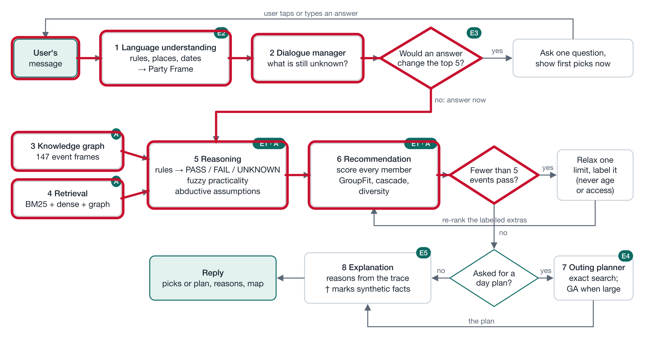
4 · USE CASE 1
A family request through the flow
“Something hands-on for my 2 kids (6 and 9) this weekend near Tampines under $30”
PARTY FRAME (LAYER 1)
you + 2 children (6, 9)
Sat 12 – Sun 13 Sep
near Tampines (10 km)
up to $30 each
crafts
Rules fired: no 12+, 13+, 16+ or 18+ ratings; budget, dates and distance are hard requirements.
Red: the path this request takes. No question would change the top five, so it answers now.
SG Culture Pass AI Chatbot · Group 4 · High-level system design
8 / 15
Notes:
ABINAYA (2:21)
For this family request, the parser extracts two children aged six and nine, weekend dates, Tampines, a thirty-dollar per-person budget and crafts. The Party Frame feeds forward-chaining rules: age restrictions exclude unsuitable ratings, while dates, price and distance constrain candidates. No clarification is needed here.

Slide 9
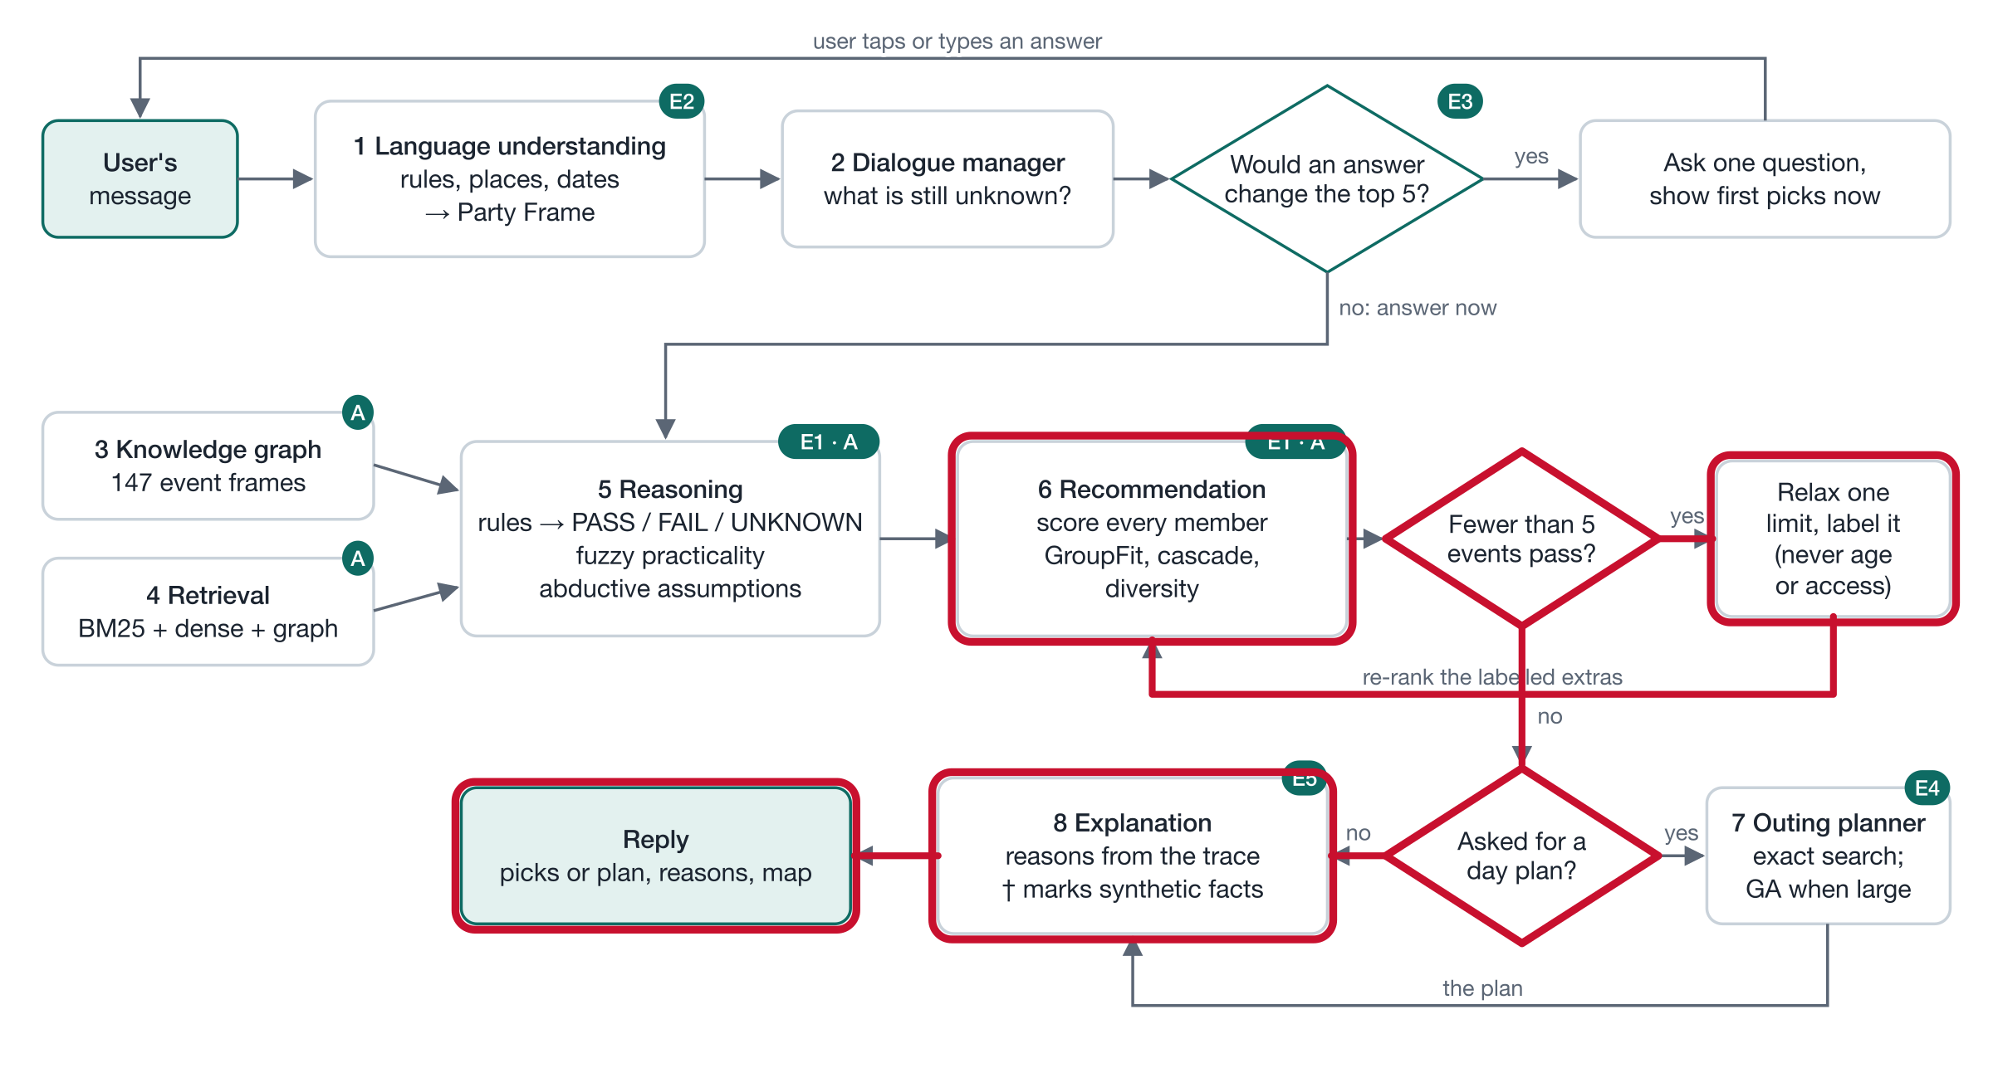
4 · USE CASE 1
Only one event fits everything, so it loosens limits openly
Only 1 exact match. Other picks are labelled alternatives: some need wider dates, a higher budget or a longer trip.
1
Roll with History: a Popiah Journey
exact match
2
The Makers' Loft: Nagomi Art Workshop
wider dates
longer trip
3
Vasily Petrenko & Gautier Capuçon
wider dates
longer trip
Limits are loosened one at a time: dates, day of week, budget, area, distance. Age and access are never loosened.
4
Paruvangal
longer trip
5
Let's Explore: a Heritage Trail
higher budget
longer trip
SG Culture Pass AI Chatbot · Group 4 · High-level system design
9 / 15
Notes:
ABINAYA (2:45)
The deductive gate checks each candidate; fuzzy practicality and group scoring help rank those that remain. Only one satisfies every stated requirement. The recommender then relaxes permitted constraints one at a time and labels each alternative. Interests are preferences, not hard limits, so some picks, even the exact match, aren't crafts.

Slide 10
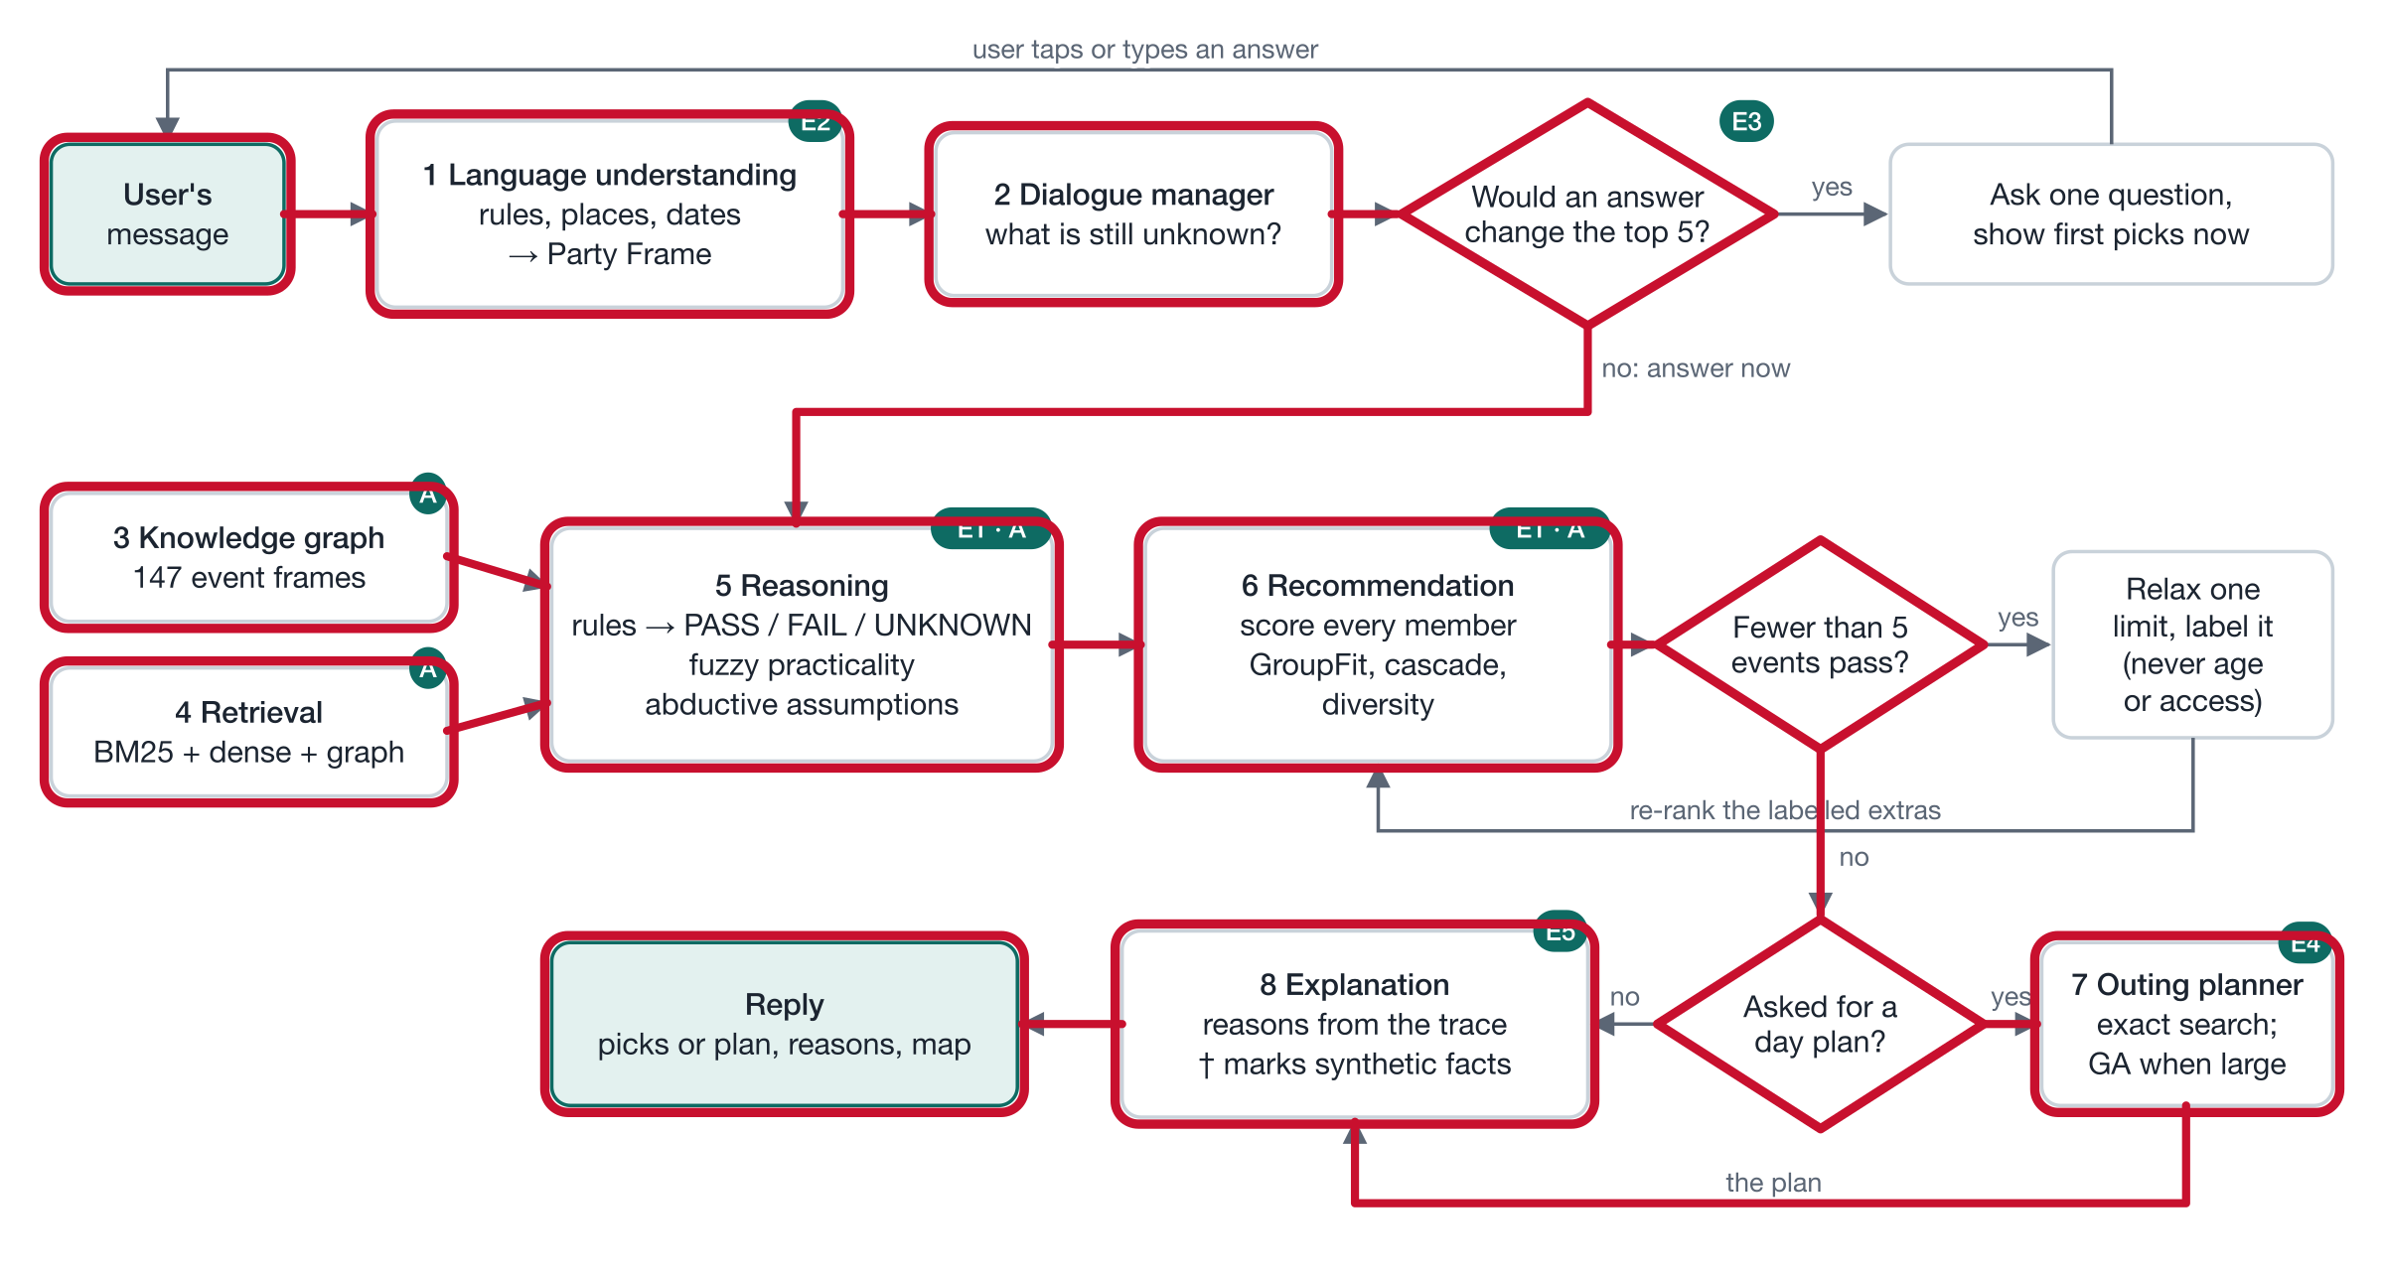
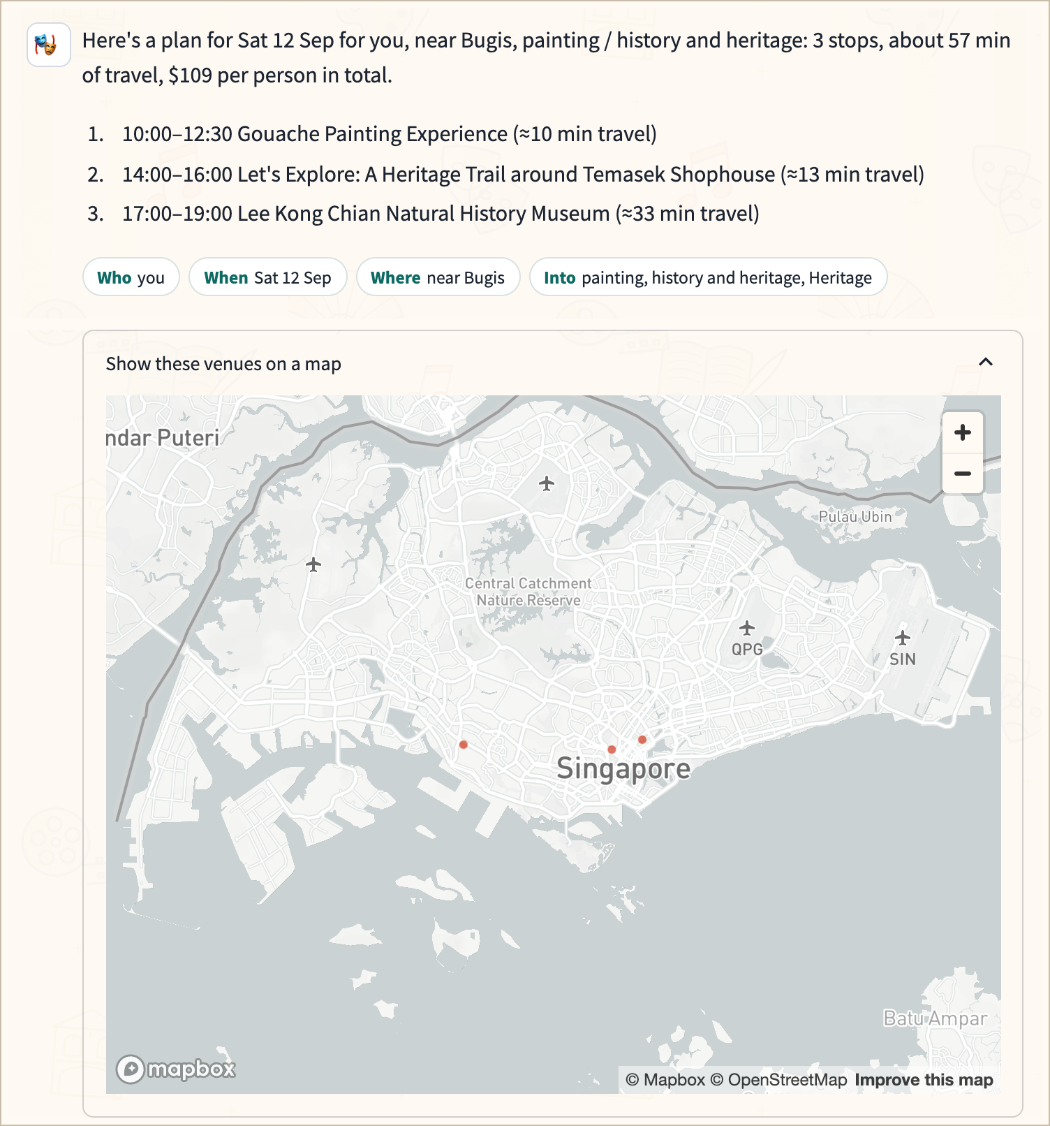
4 · USE CASE 2
Plan my Saturday near Bugis
“Plan my Saturday near Bugis: painting and heritage, 3 things”
Exact search checks 1,320 ordered 3-stop plans from 12 candidates. Feasible timing matters: group fit − travel − idle time + variety.
SG Culture Pass AI Chatbot · Group 4 · High-level system design
10 / 15
Notes:
ABINAYA (3:13)
The second use case asks for three stops near Bugis. Picking the three highest-ranked events separately can fail because sessions overlap or venues are far apart. Exact search checks feasible orders and maximises group fit and variety while penalising travel and waiting. Larger candidate pools switch to a genetic algorithm.

Slide 11
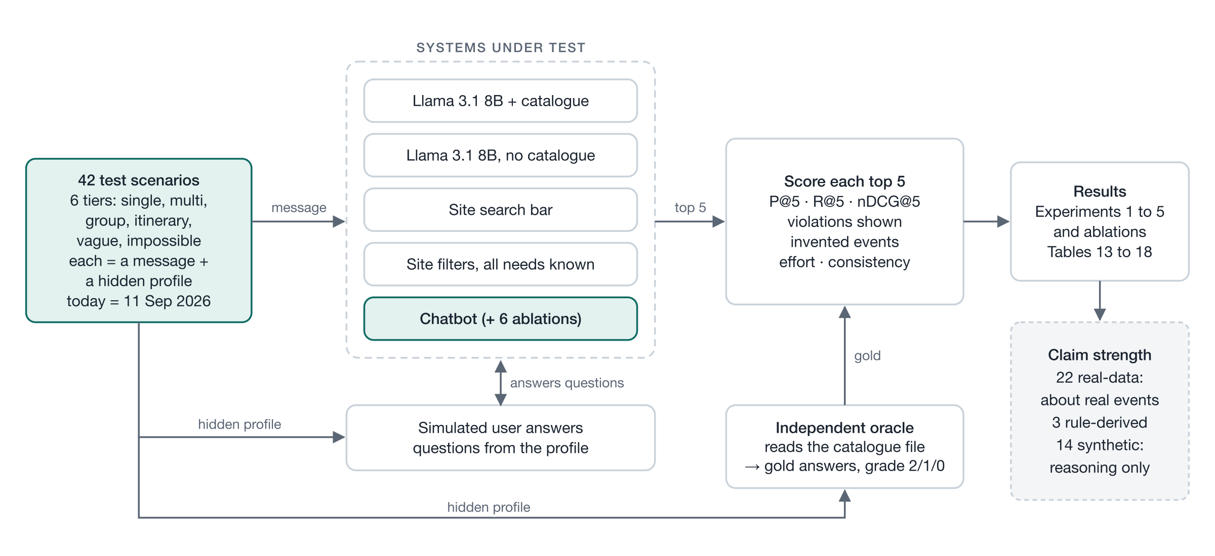
5 · EVALUATION
How we tested it fairly
The site-filter user is given every hidden need, so that baseline is deliberately strong. Every baseline runs locally, so anyone can re-run the numbers.
SG Culture Pass AI Chatbot · Group 4 · High-level system design
11 / 15
Notes:
SARANYA (3:40)
We evaluated 42 scenarios across six tiers using an independent catalogue-based oracle. The site-filter baseline was deliberately strong: it knew all hidden needs. A simulated user answered the chatbot’s clarifying questions. We also tested keyword search and local Llama with and without the catalogue.

Slide 12
5 · EVALUATION
What the numbers show
0
invented events. Llama without the catalogue invented 180 of the 205 it named.
1.5
messages on average, against 5.6 filter clicks for the informed site user.
Where it falls short Very vague requests: 0.57, against 0.72 for a site user who knows every need. · GroupFit's benefit over a simple average is not yet shown.
SG Culture Pass AI Chatbot · Group 4 · High-level system design
12 / 15
Notes:
SARANYA (4:04)
On 39 answerable scenarios, nDCG at five was 0.92 for our chatbot, versus 0.72 for informed site filtering and 0.27 for Llama with the catalogue. It invented no events. Limitations remain: vague requests, synthetic attributes, team-authored tests, and no measured GroupFit gain over simple averaging. Nor does it yet learn across users.

Slide 13
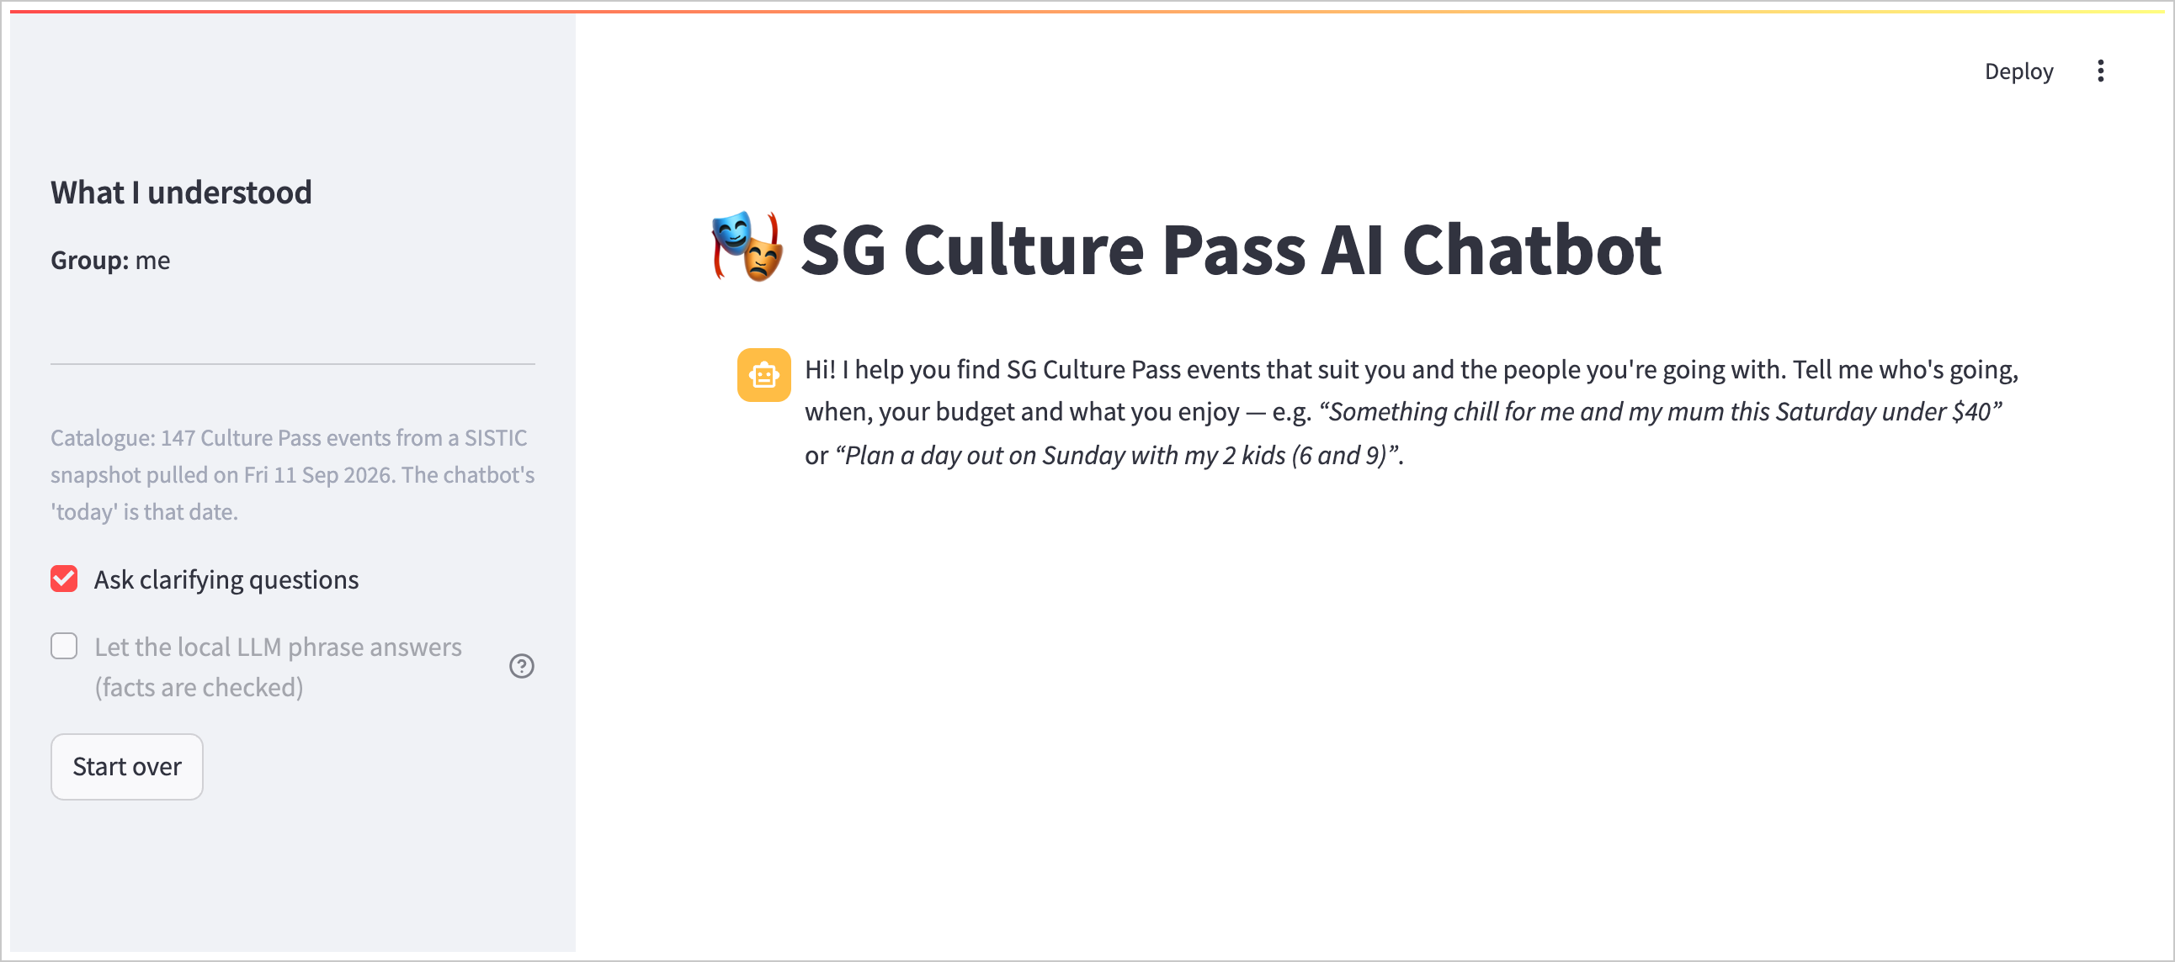
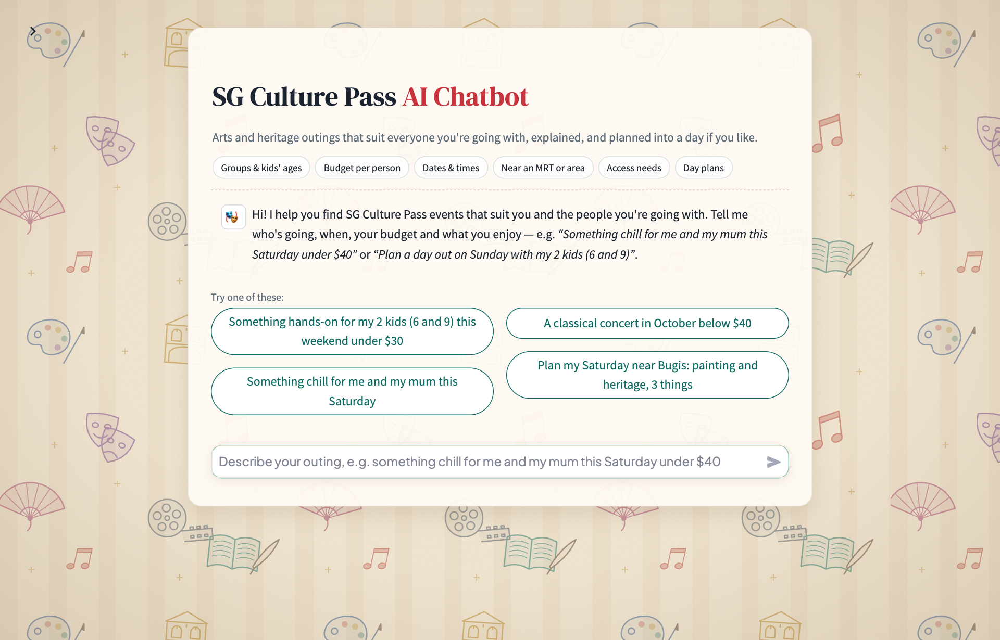
6 · USER INTERFACE
From a developer screen to a visitor's guide
BEFORE
AFTER
Internals first: a “What I understood” panel and settings, and no hint of what to ask.
Shows what it can do: six topic buttons you can tap, such as Budget per person, and the chatbot asks about that topic; plus four example requests to tap (Amershi et al., 2019).
SG Culture Pass AI Chatbot · Group 4 · High-level system design
13 / 15
Notes:
ADHITHI (4:32)
We also redesigned the visitor interface around clear examples rather than exposing developer controls first. Users can tap a topic button, such as Budget per person, and the chatbot asks about it with one-tap answers.

Slide 14
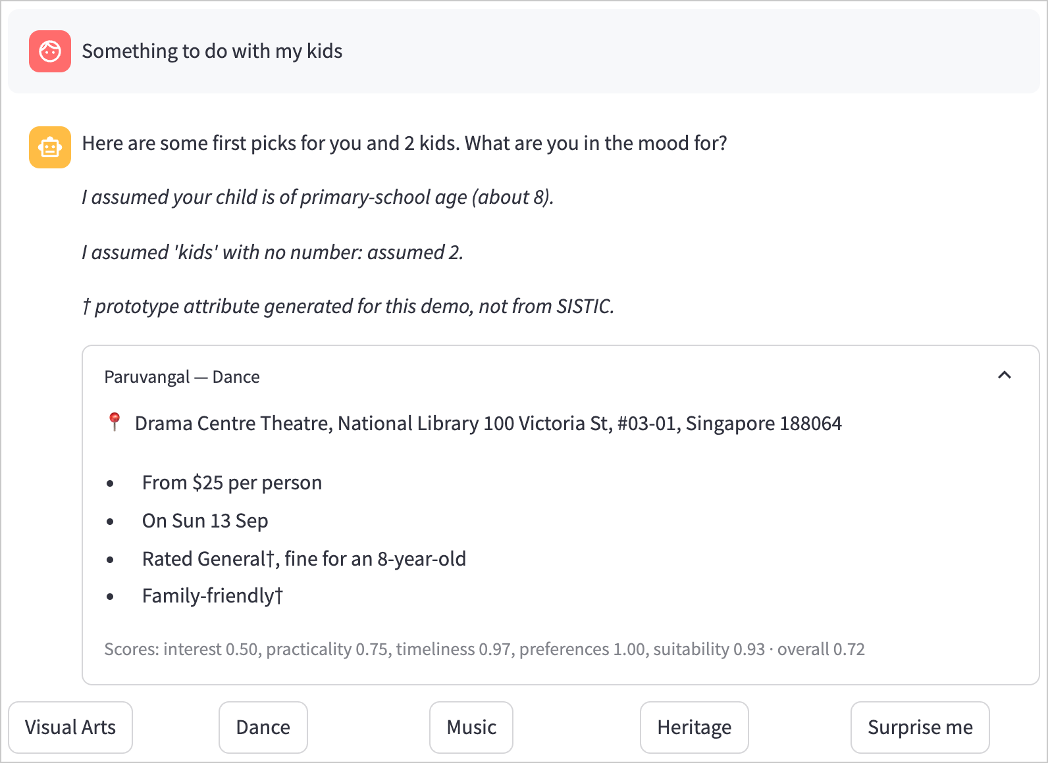
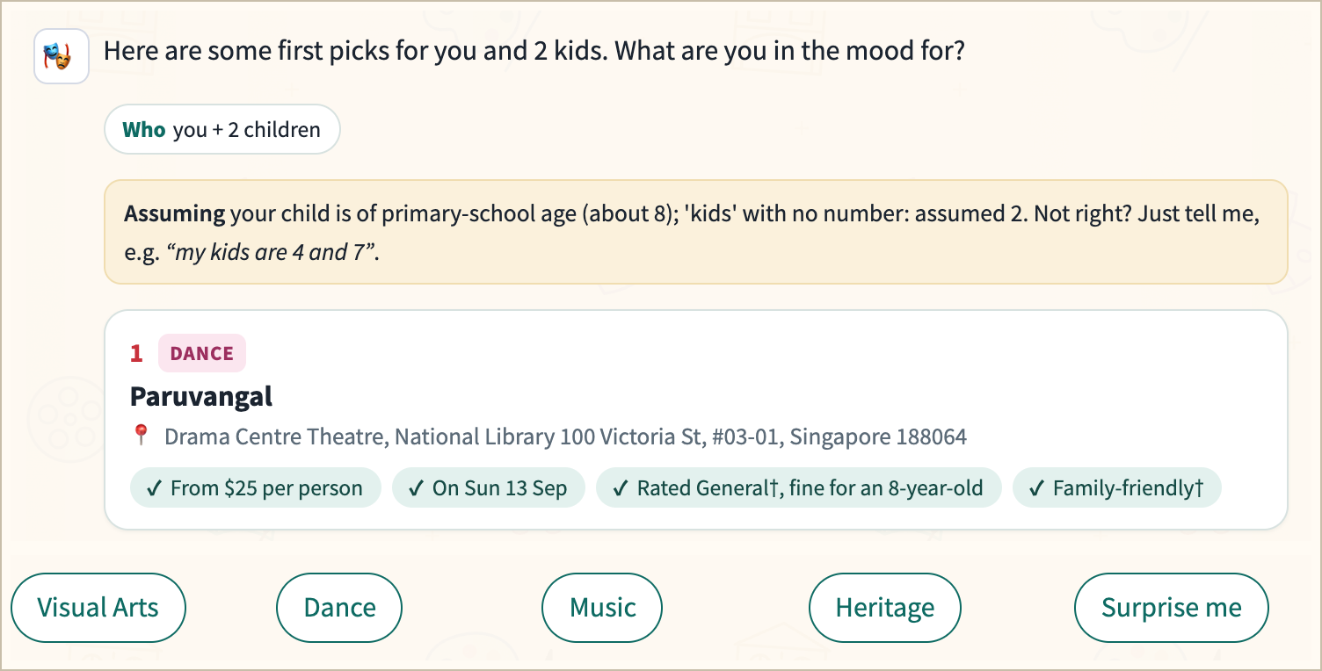
6 · USER INTERFACE
Replies you can check and correct
BEFORE
AFTER
Assumptions in italics; long cards with raw scores.
Request chips, one “Assuming” line you can correct, compact cards and one-tap answers (Budiu, 2018). Internals move behind “Show how it works”.
SG Culture Pass AI Chatbot · Group 4 · High-level system design
14 / 15
Notes:
ADHITHI (4:51)
Replies now show understood requirements, correctable assumptions and concise reasons. Detailed traces remain available for assessors.

Slide 15
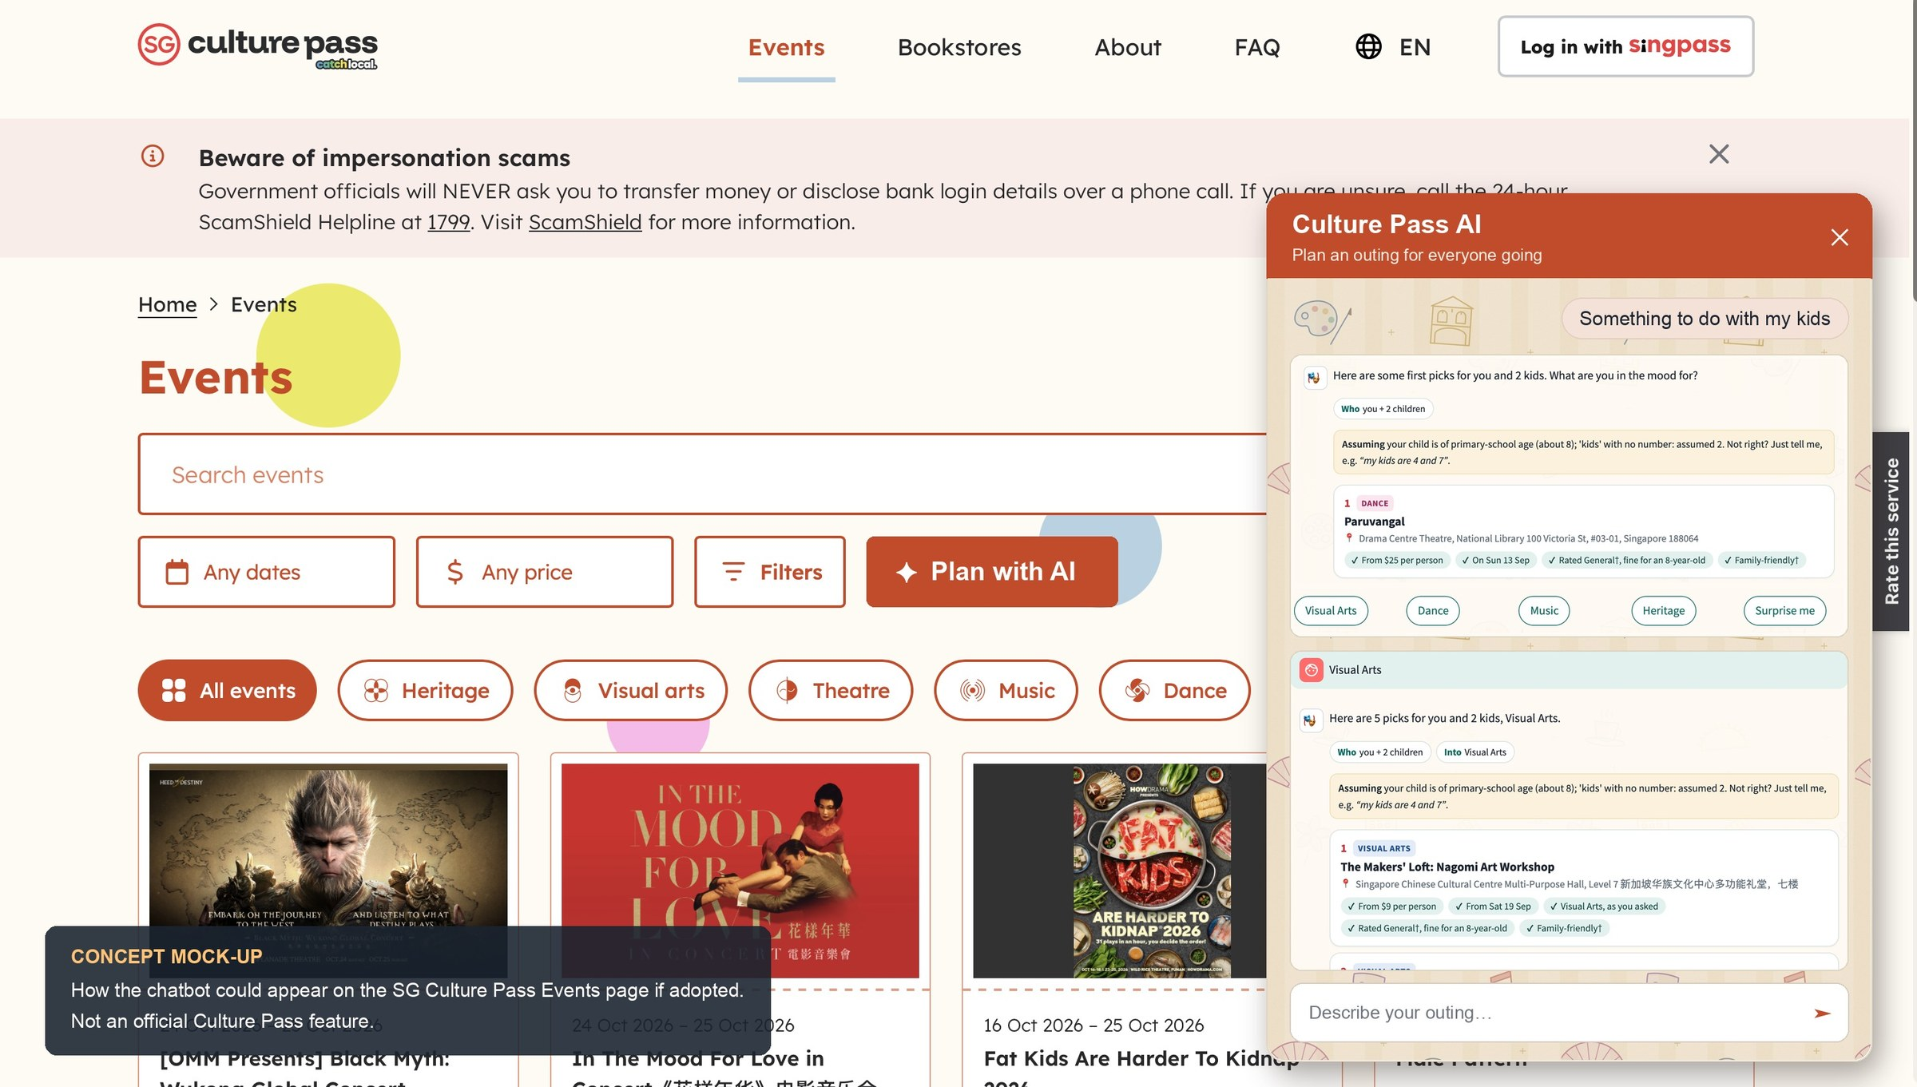
TRY IT sg-culture-pass-chatbot.streamlit.app
Thank you
Code, data and evaluation: github.com/saranya-sai/SG-Culture-Pass-Chatbot
Notes:
ADHITHI (5:00)
The prototype and reproducible evaluation are linked here, and this is how the chatbot could look on the Culture Pass site. Thank you.

